Slide 1


DATA STRUCTURES USING C Lecture 1
Prof. P. S. Avadhani
M. Tech., PhD., F.I.E,FCSI, FAPAS.
Visiting Professor, Central University of Odisha
Former Director, IIIT, Agartala
Former Principal, AU College of Engg,
Andhra University, Visakhapatnam

Slide 2
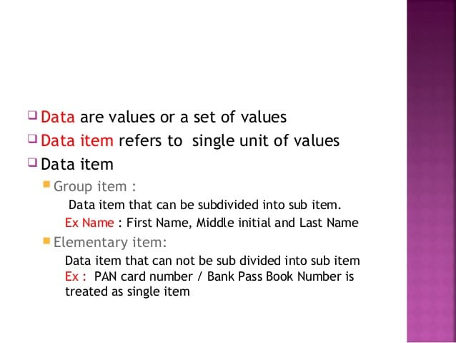
Data

Slide 3
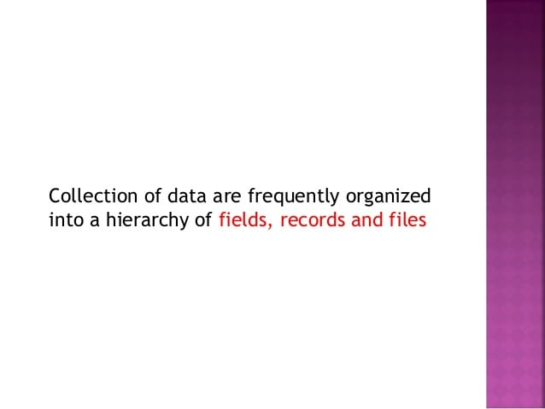
Fields-Records-Files

Slide 4
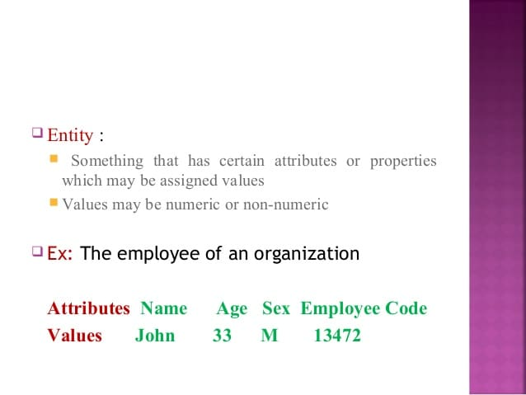
Entity

Slide 5
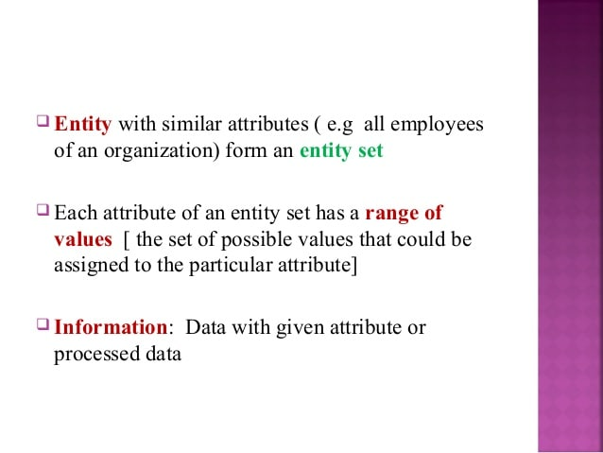
Entity set

Slide 6
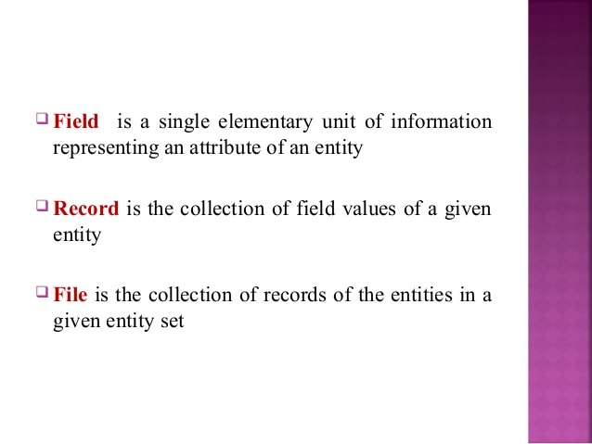
Field-Record-File (Revisited)

Slide 7
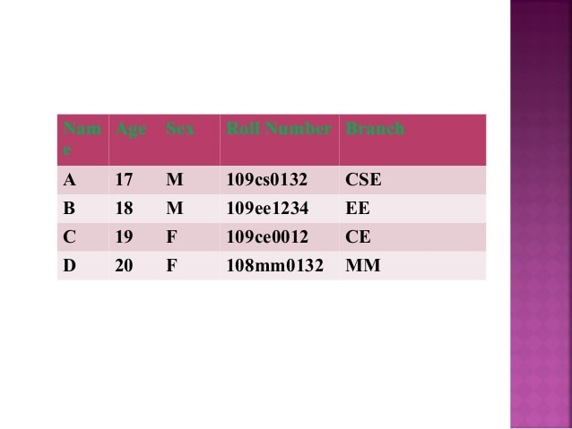
Example

Slide 8

Record

Slide 9
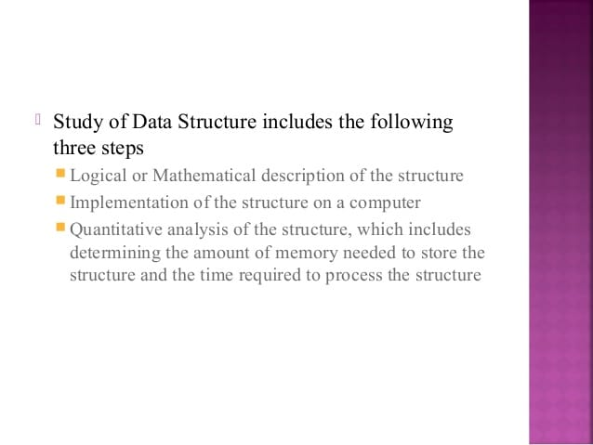
Study of Data structures
Amount memory is no more an issue because the memory has become very cheap now ( in terms of its cost)

Slide 10
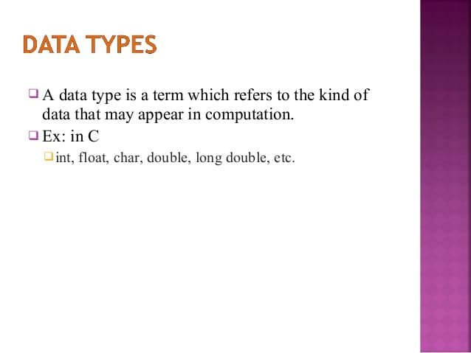
Data Types

Slide 11
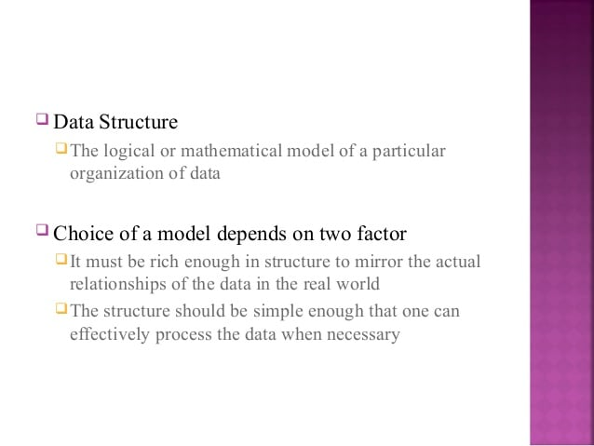
Data Structure

Slide 12
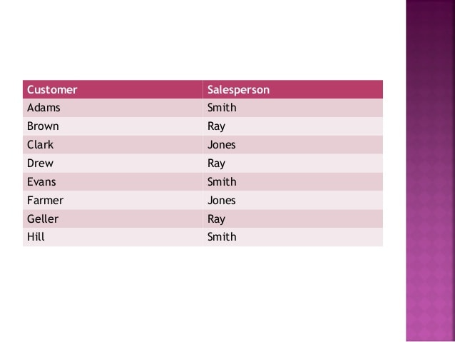
Example ( Array)

Slide 13
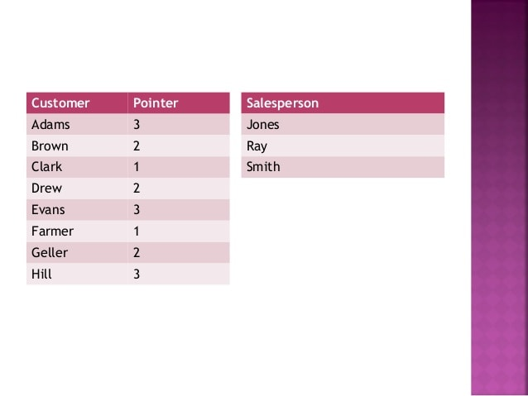
Contd…

Slide 14
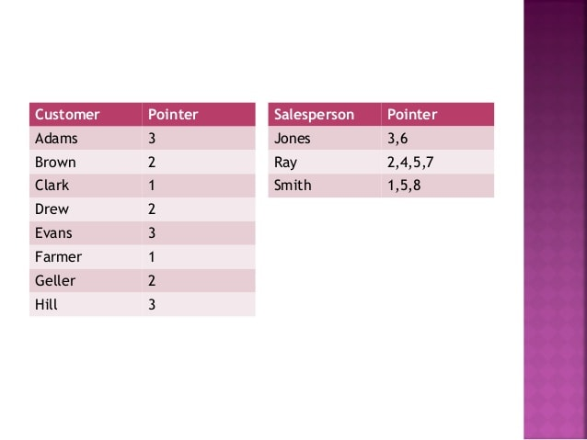
Contd…

Slide 15
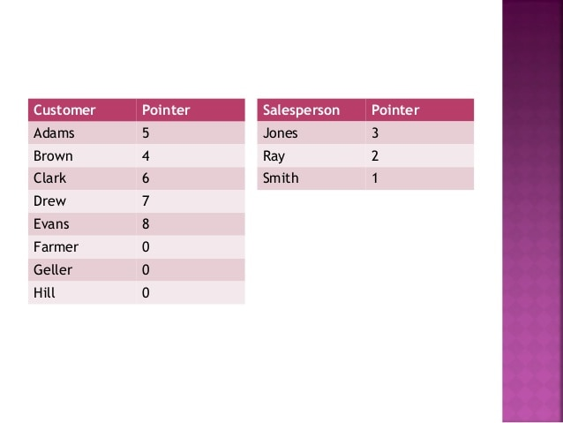
Contd….

Slide 16
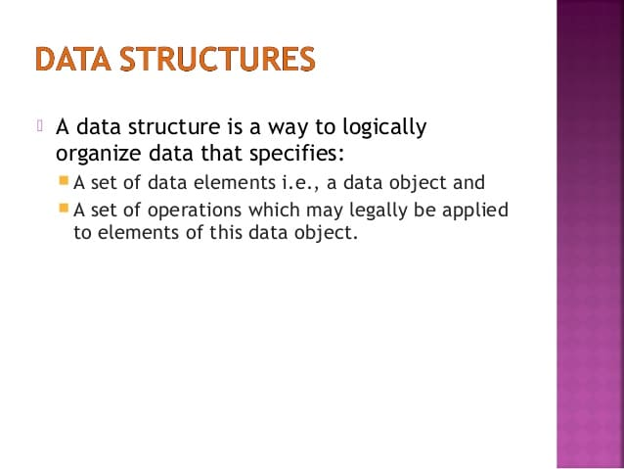
Data structures

Slide 17
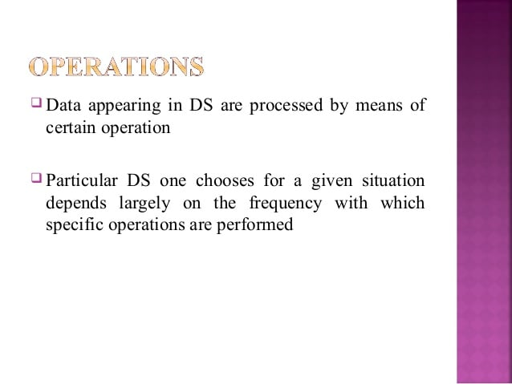
Operations

Slide 18
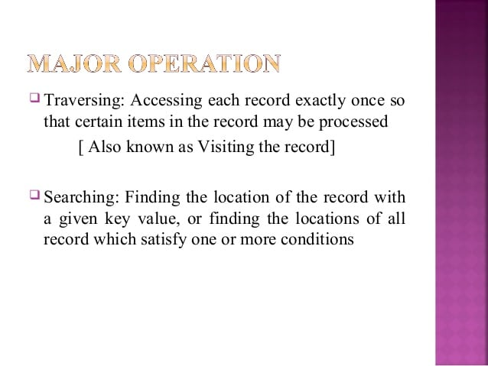
Major Operations

Slide 19
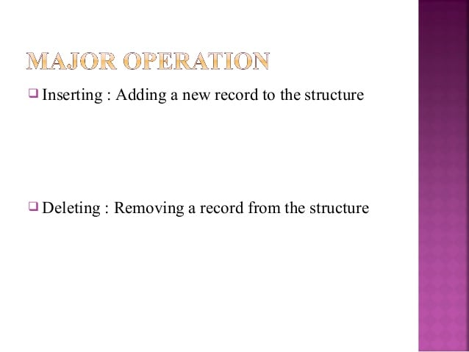
Continued…

Slide 20
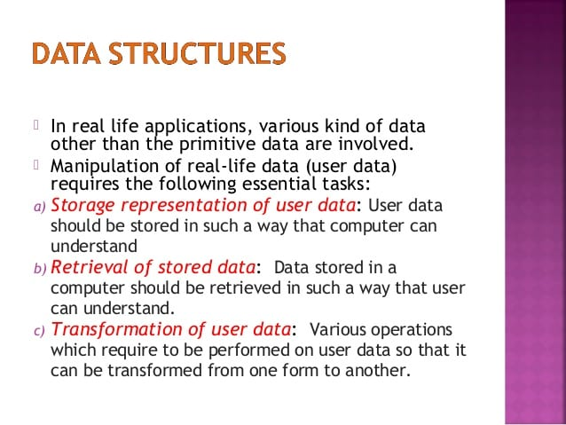
Examples

Slide 21
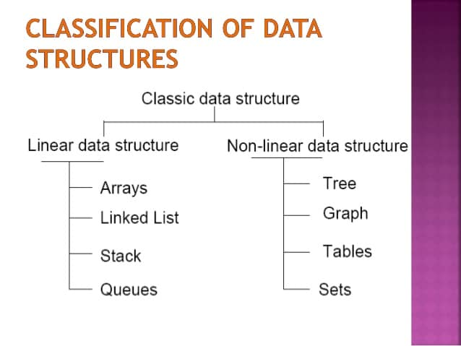
Classification

Slide 22
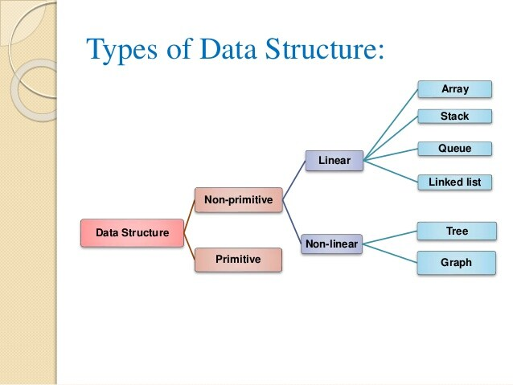
Classification

Slide 23
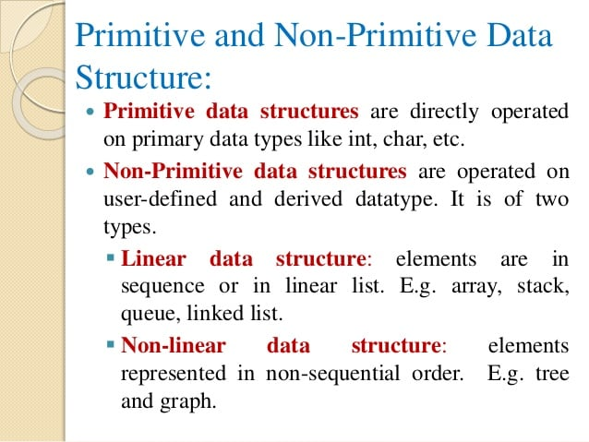
Explanation

Slide 24
ABSTRACT DATA TYPES
ADT refers to a set of data values and associated operations that are specified accurately, independent of any particular implementation.
With an ADT, what data types are useful for implementation is known but how actually it is done is not mentioned.
ADT consists of a set of definitions that allow us to use the functions while hiding the implementation.

Slide 25
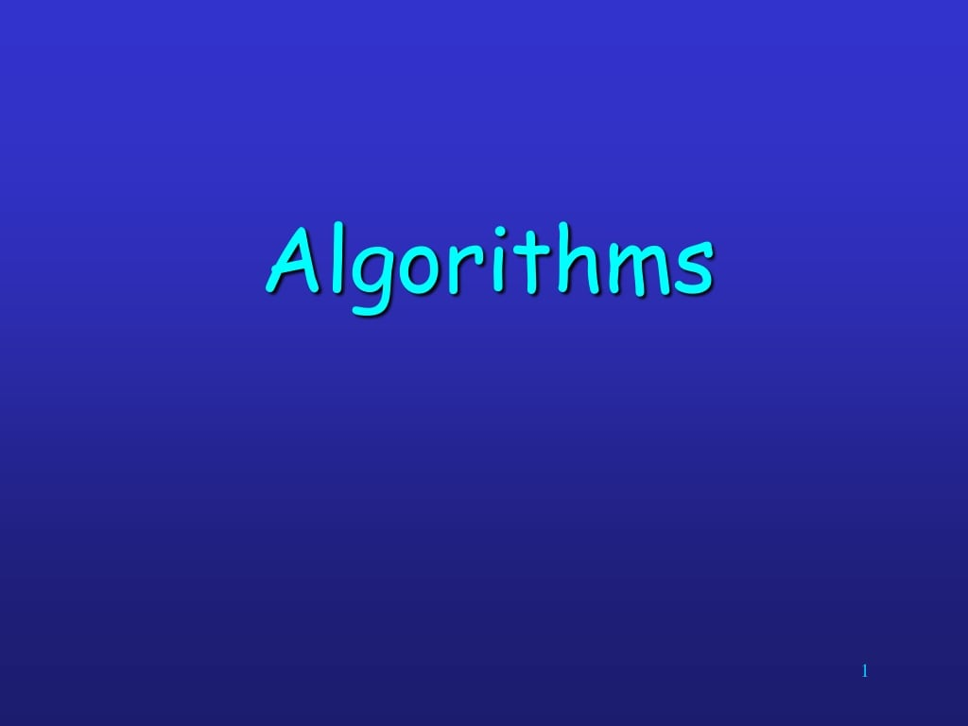

Slide 26
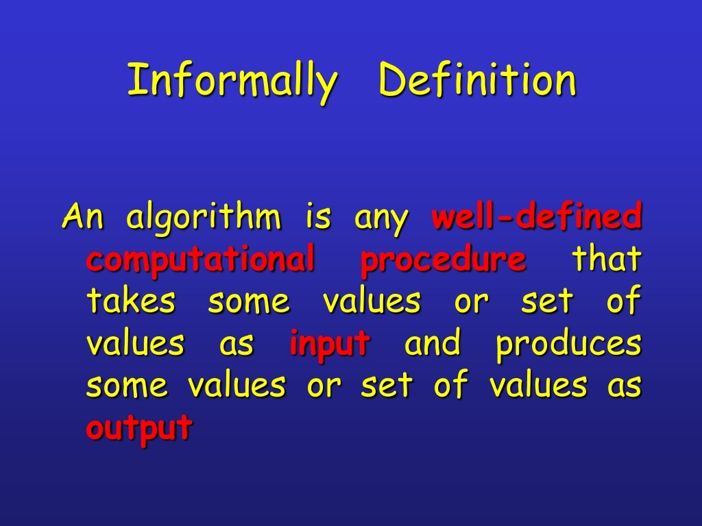

Slide 27
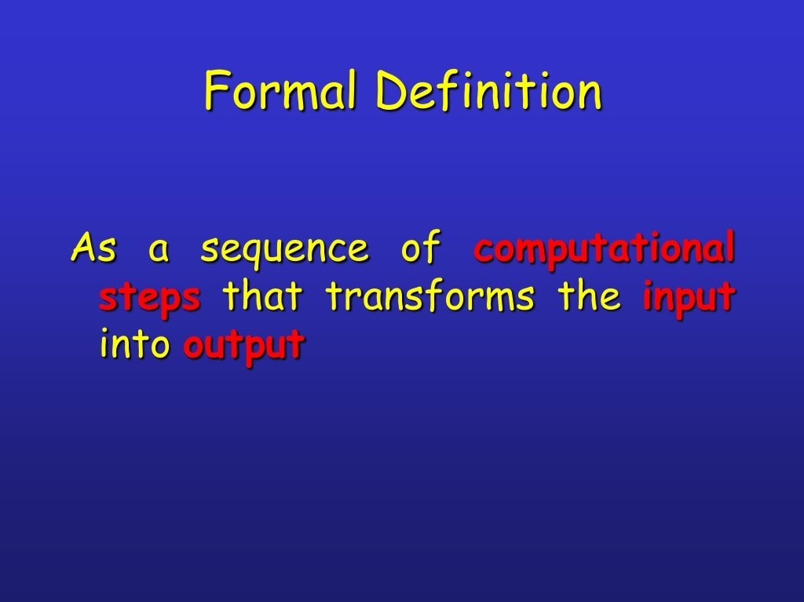

Slide 28
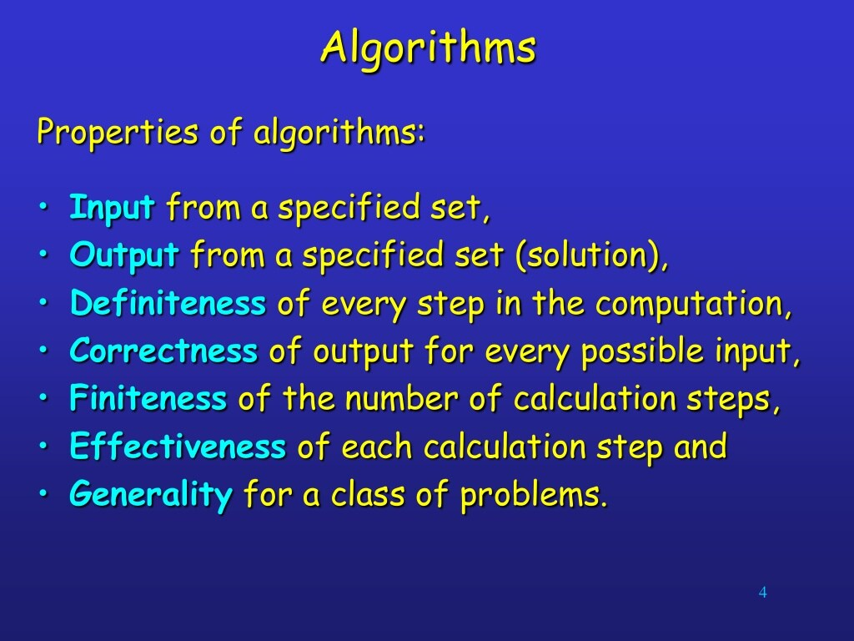

Slide 29
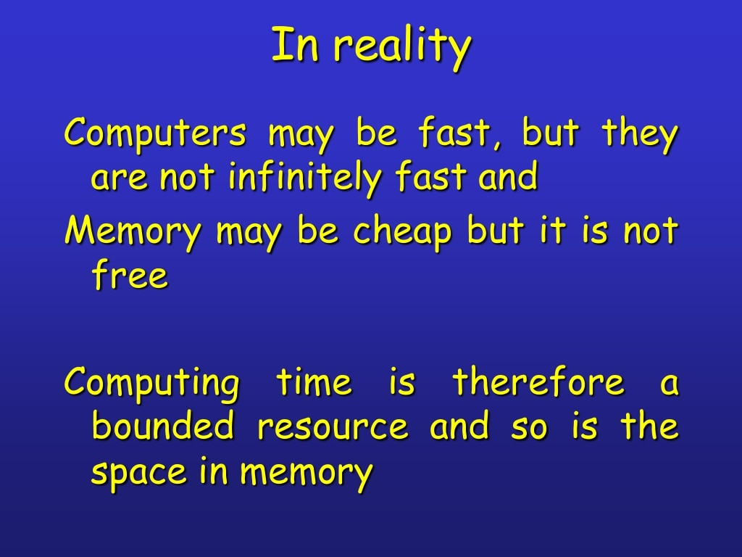

Slide 30
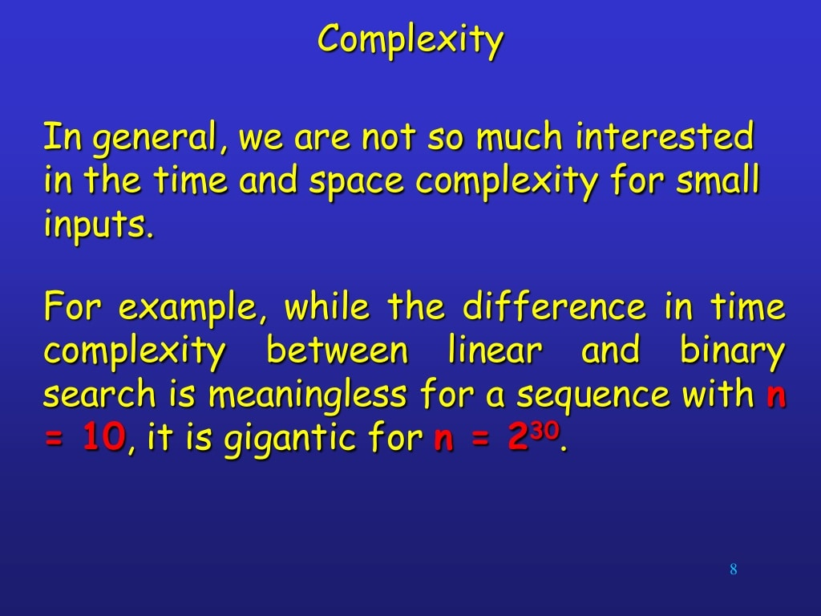

Slide 31
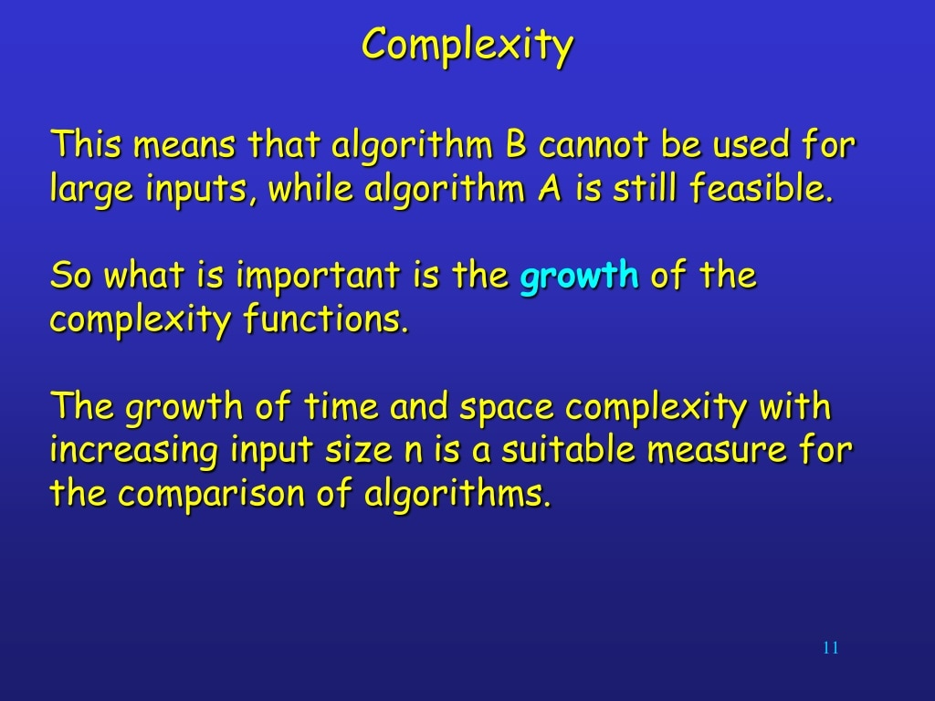

Slide 32
Linear Search
Search the numbers 15, 31 in the given array of numbers
17 | 3 | 12 | 16 | 19 | 37 | 15 | 61 | 63 | 6
Search the numbers 31 in the given array of numbers
17 | 3 | 12 | 16 | 19 | 37 | 15 | 61 | 63 | 6

Slide 33
Binary Search
Search the numbers 61 in the given array of numbers
7 | 13 | 22 | 36 | 49 | 57 | 65 | 71 | 83 | 96
Search the numbers 71 in the given array of numbers
7 | 13 | 22 | 36 | 49 | 57 | 65 | 71 | 83 | 96

Slide 34
Questions?

Slide 35
Thank You

Slide 36
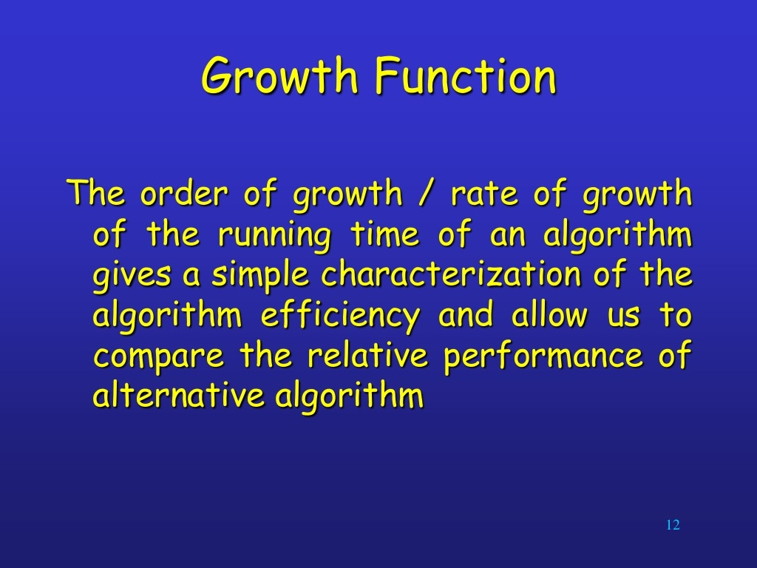

Slide 37
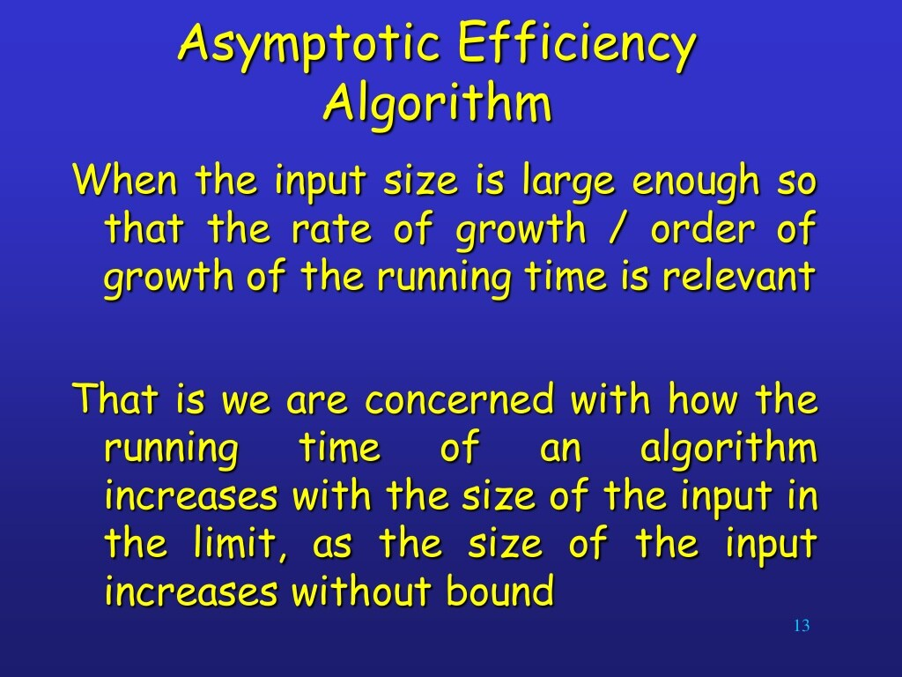

Slide 38
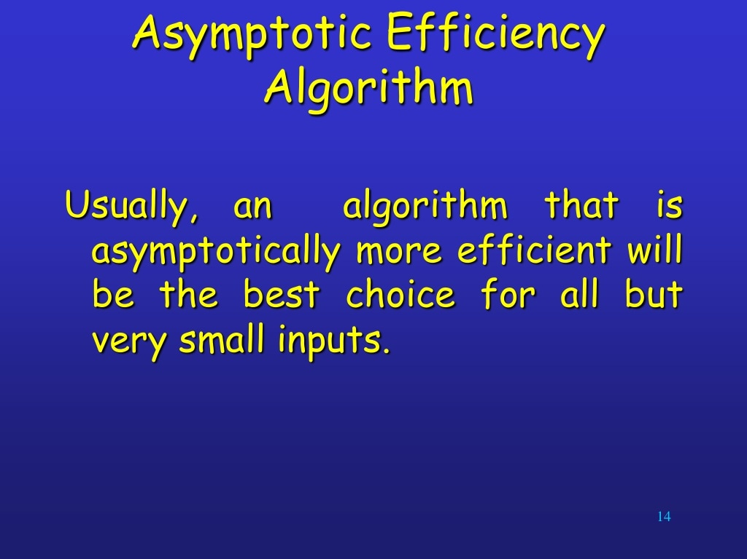

Slide 39
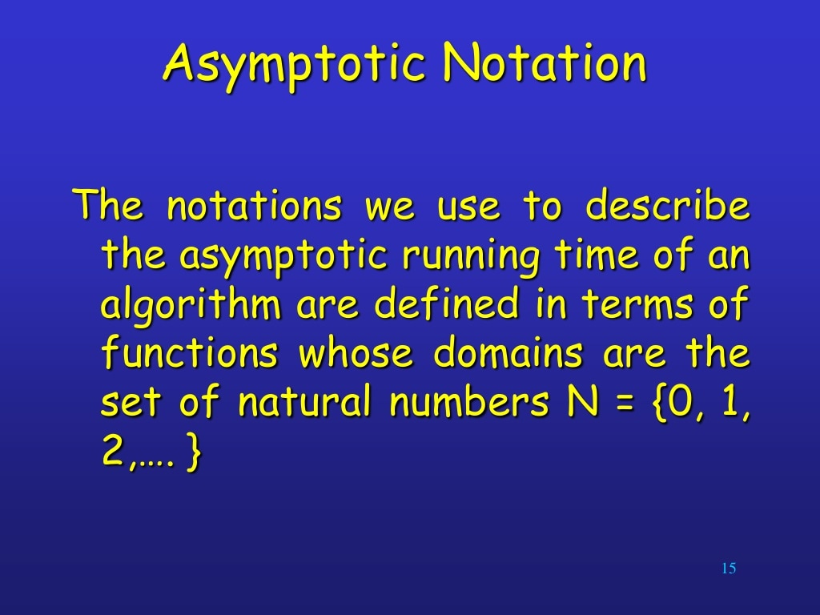

Slide 40
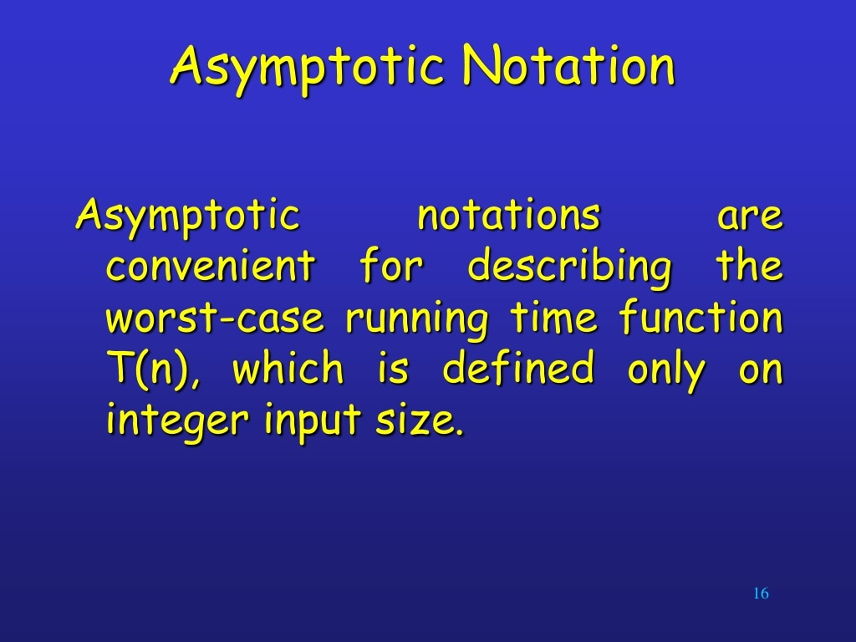

Slide 41
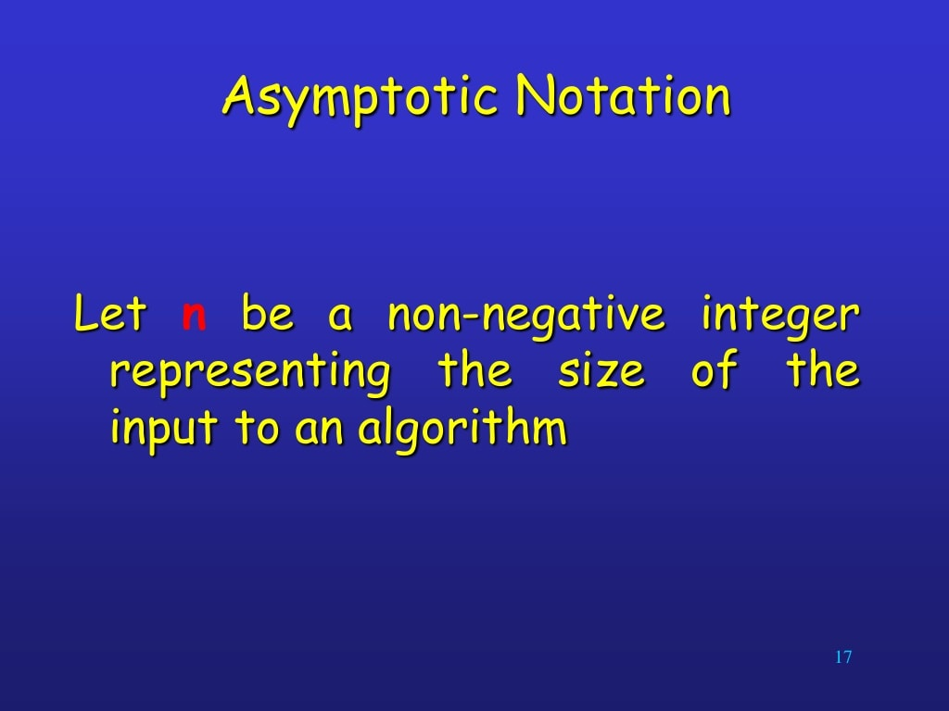

Slide 42
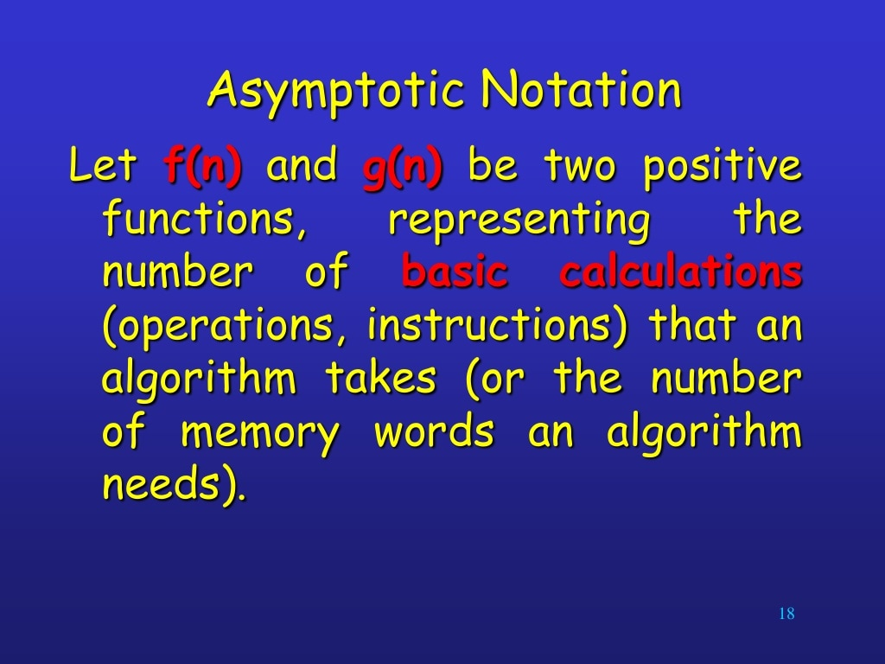

Slide 43
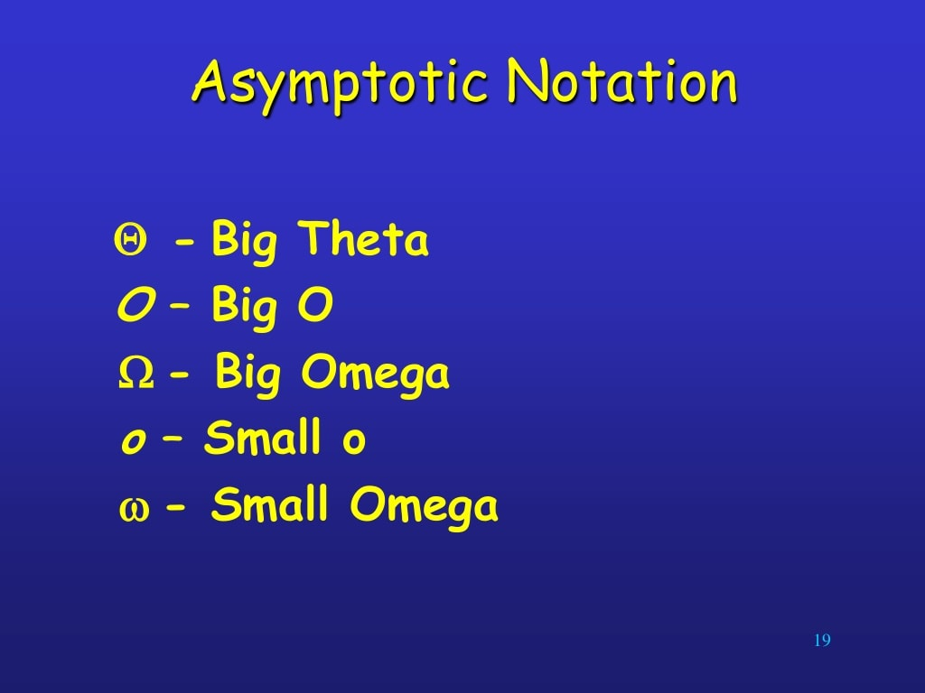

Slide 44
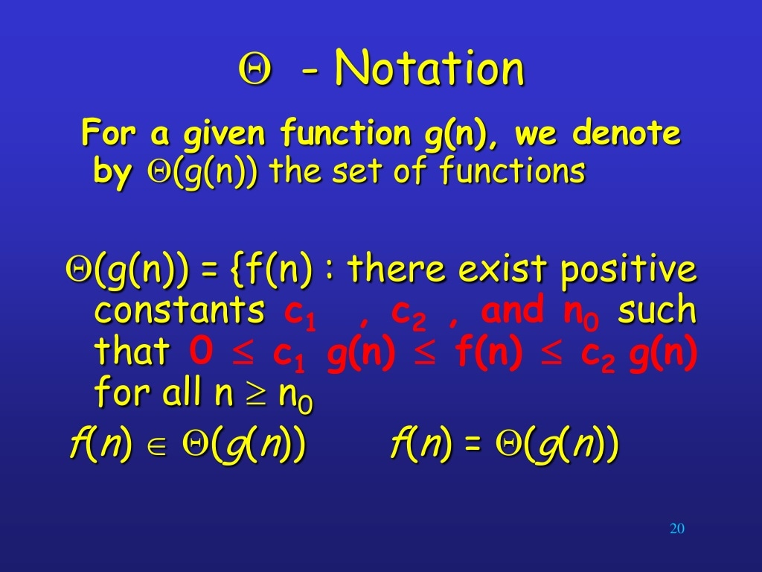

Slide 45
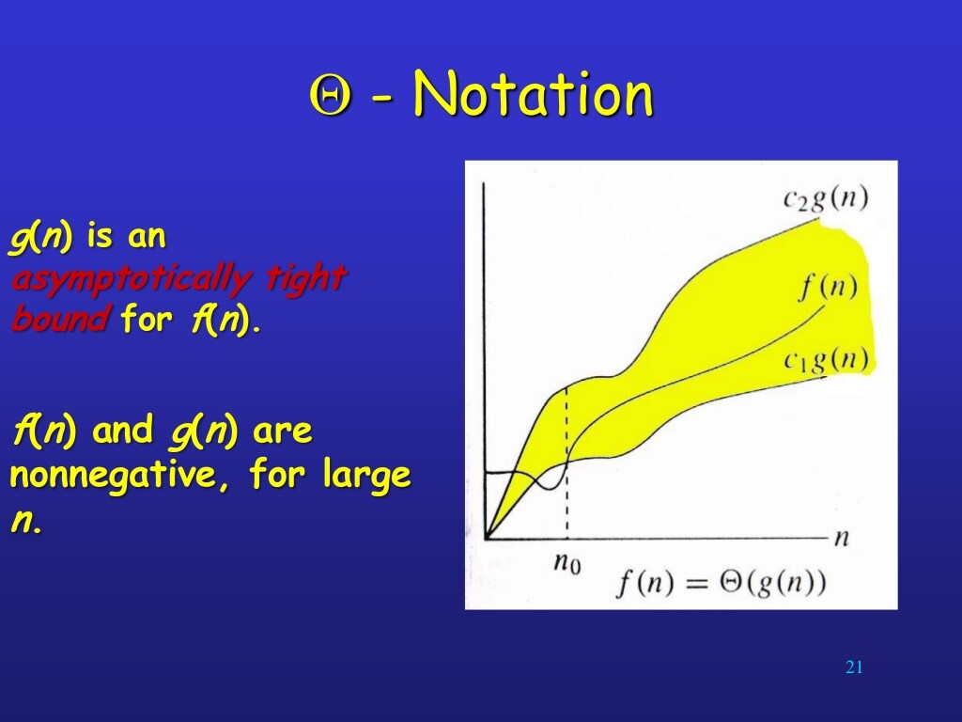

Slide 46
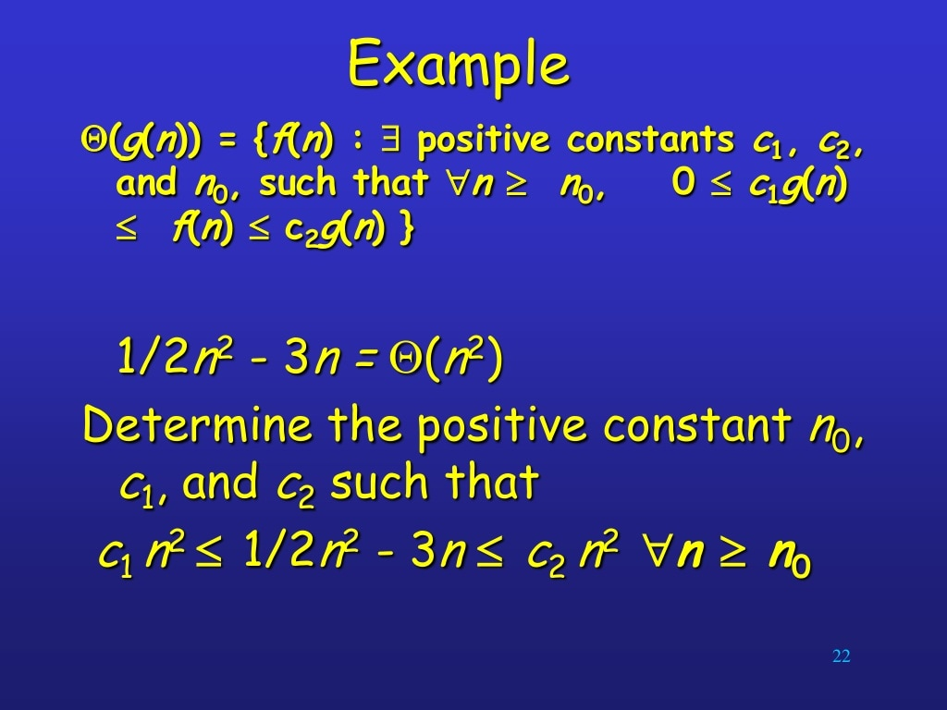

Slide 47
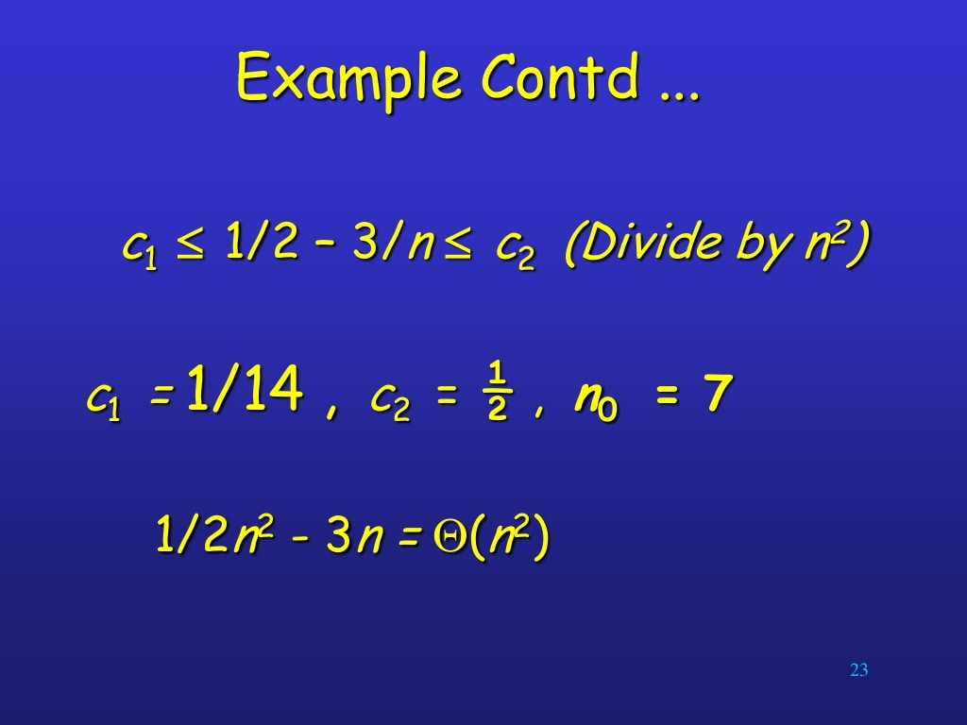

Slide 48
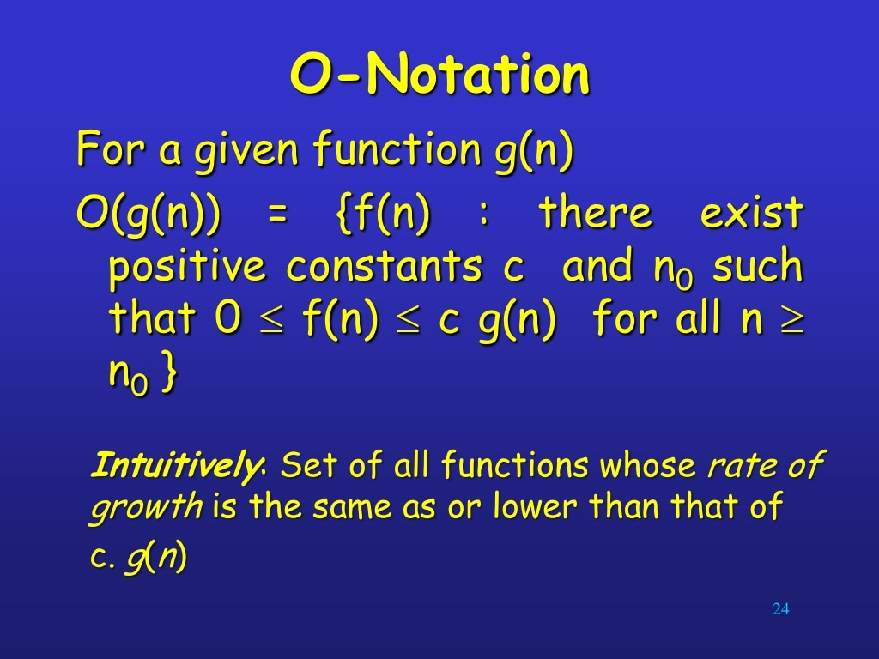

Slide 49
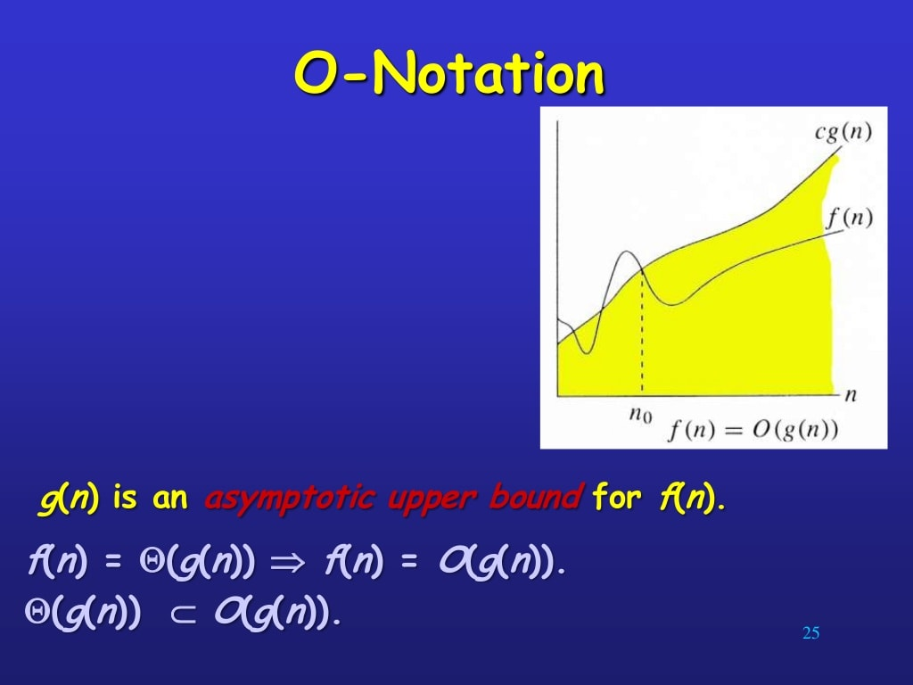

Slide 50
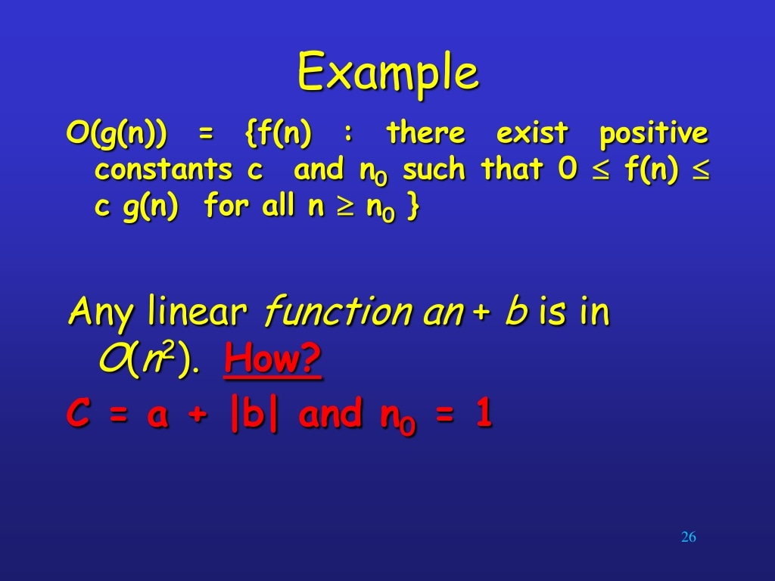

Slide 51
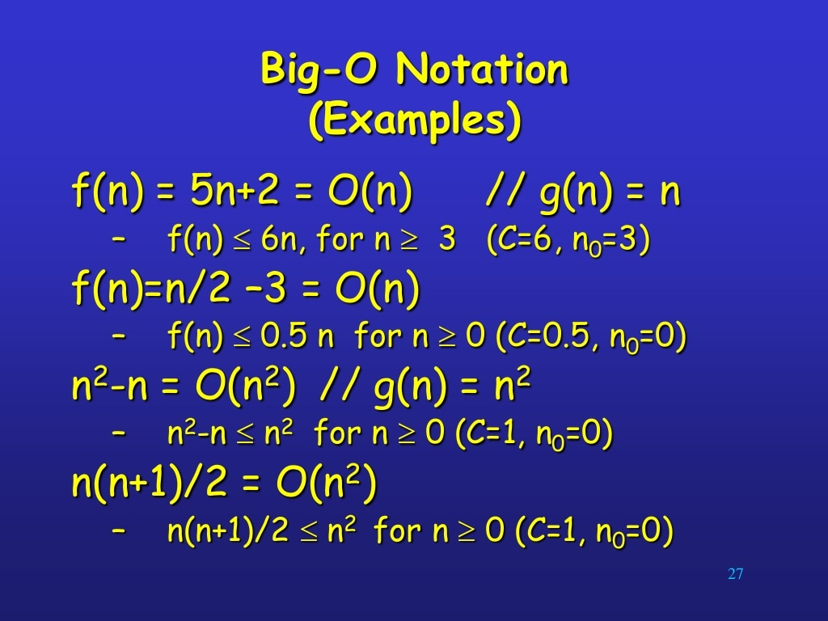

Slide 52
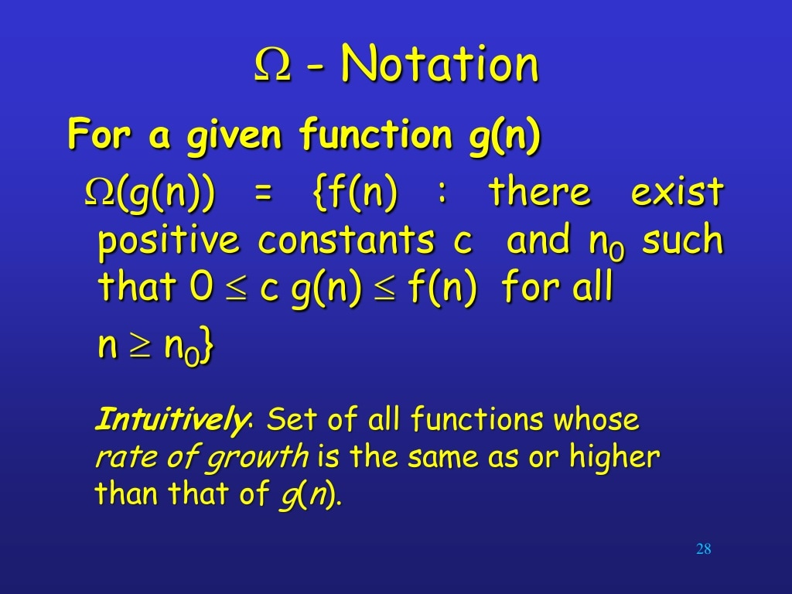

Slide 53
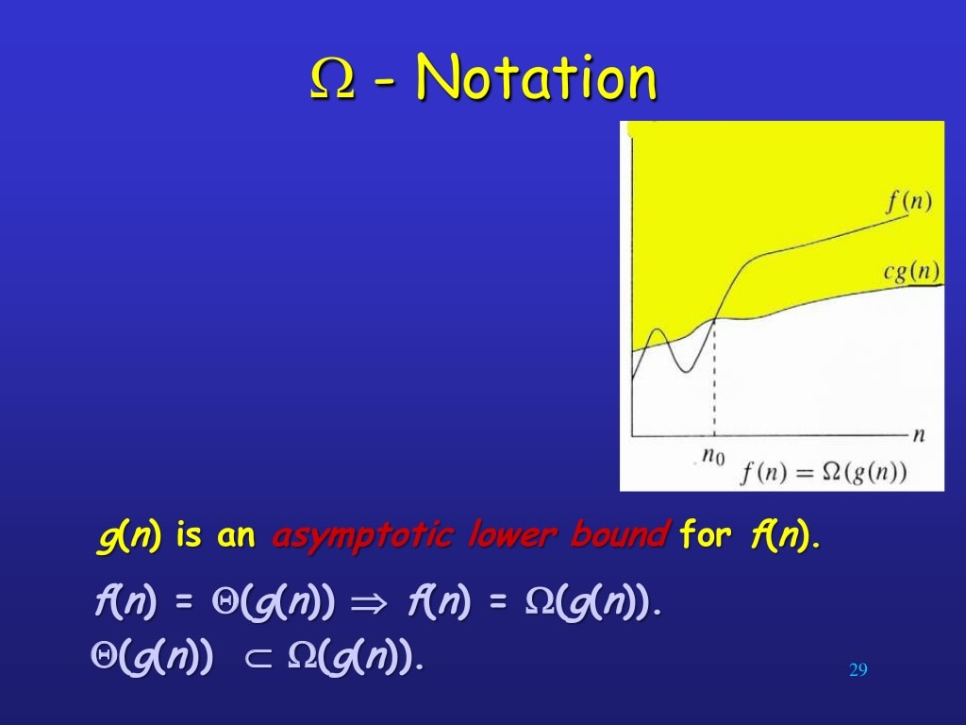

Slide 54
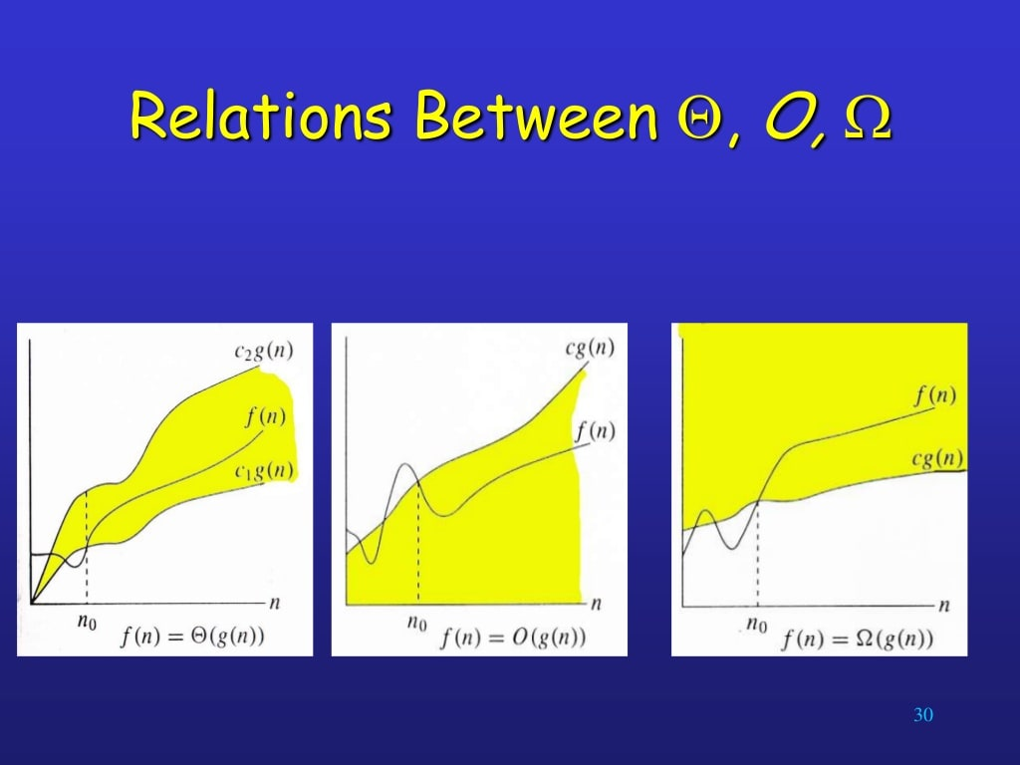

Slide 55
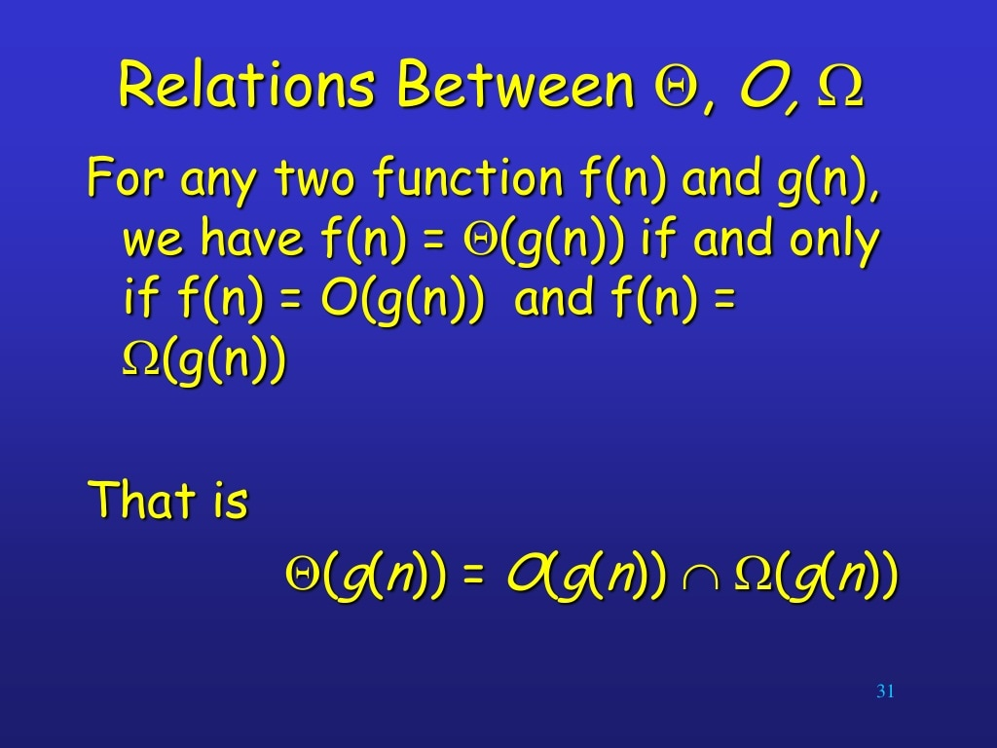

Slide 56
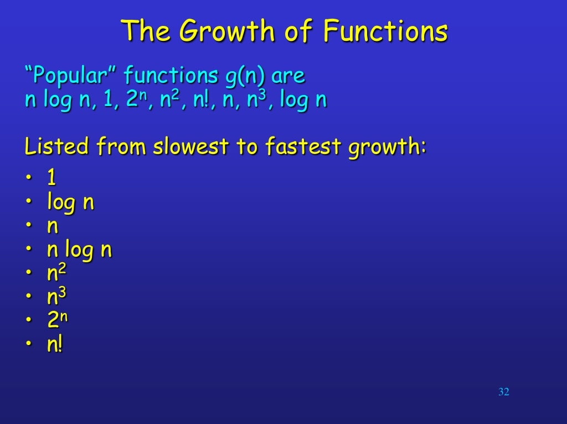

Slide 57
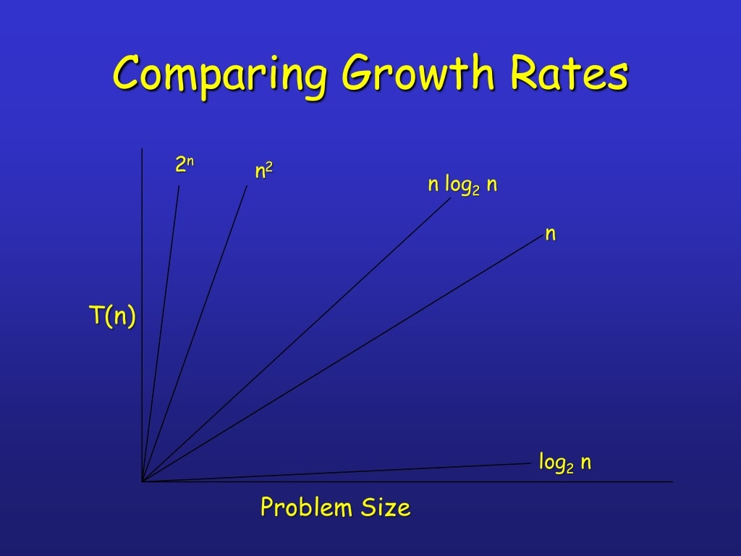

Slide 58


Slide 59
Questions?

Slide 60
Thank You

